Slide 1
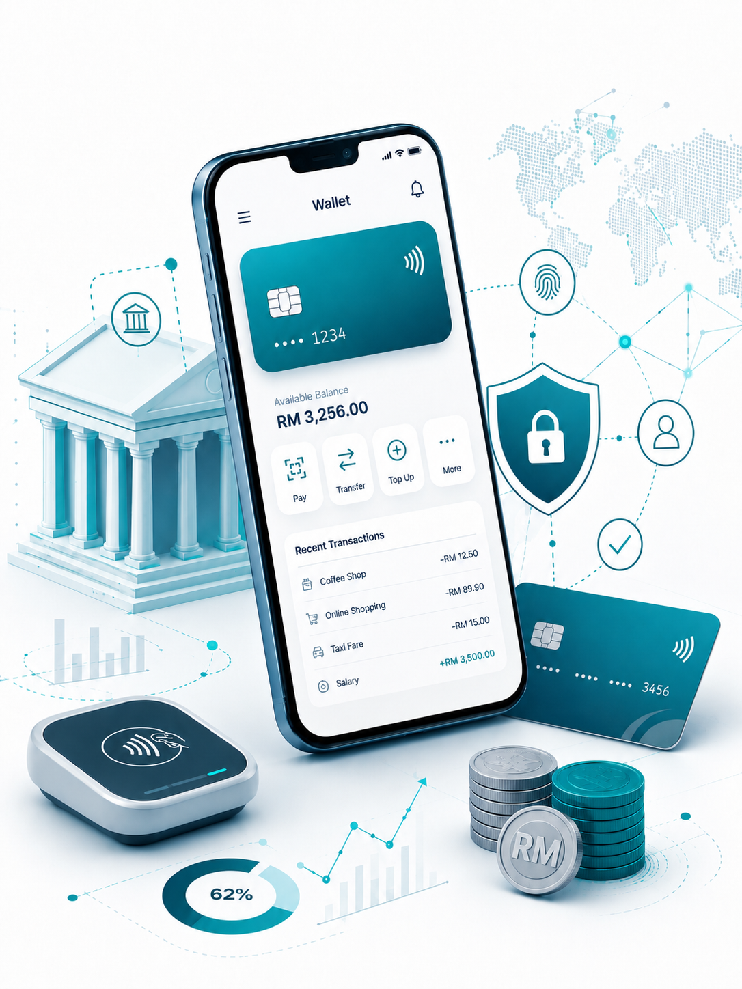

Insert relevant picture related to the topic
TFB3323 FINTECH INNOVATION
WEEK VIII
DIGITAL-ONLY BANKS
Shuhaida Bt M Shuhidan
(Dr (FSMC/UTP))
BACHELOR OF XXXXXX
DEPARTMENT OF COMPUTING
FACULTY OF SCIENCE, MANAGEMENT & COMPUTING
© 2026 INSTITUTE OF TECHNOLOGY PETRONAS SDN BHD
All rights reserved. No part of this document may be reproduced, stored in a retrieval system or transmitted in any form or by any means (electronic, mechanical, photocopying, recording or otherwise) without the permission of the copyright owner.

Slide 2
RECAP FROM PREVIOUS LECTURE
The Core Concept: Blockchain is a decentralized, peer-to-peer ledger that lets users transfer value directly without a middleman like a bank. It is an append-only database, meaning all recorded transactions are permanent and unchangeable.
How It Works: Data is grouped into chronological chunks called blocks, with each given an exact timestamp. It uses asymmetric cryptography (public and private keys) to safely identify accounts and securely sign transactions.
Top Benefits: It improves security because data is copied across an entire network instead of stored on a single server. It also provides full transparency, instant audit trails for tracking assets, and faster clearing speeds.
Network Roles & Automation: Standard network nodes maintain and validate the ledger, while specialized nodes called miners verify the blocks. Processes can also be automated using "smart contracts" that trigger actions automatically once set conditions are met.
Real-World Impact: Multiple industries use it to cut out paperwork and delays, including banking for instant settlements, supply chains for tracking goods, and insurance for auto-paying claims.
Notes:
Learning Outcomes Slide
Note:
Include 2–4 lecture-level learning outcomes
Use measurable action verbs
Map explicitly to Course Learning Outcomes (CLOs)

Slide 3
LEARNING OUTCOMES
By the end of this session, students will be able to:
Understand Big Tech's Advantages: Explain how tech giants use their massive user bases, daily engagement, and consumer trust to disrupt finance.
Analyze Tech Giants' Strategies: Differentiate the goals of each company, such as Google and Facebook seeking data for ads , Amazon aiming to boost retail sales , and Apple broadening iPhone utility.
Evaluate the "Super App" Model: Examine how Chinese firms like Alibaba and Tencent integrated finance into lifestyle apps, creating a template for global "TechFin".
Identify Incumbent Banks' Strengths: Assess the unique assets traditional banks retain, including transactional data , physical branches , high consumer privacy trust , and specialized expertise.
Assess FinTech Collaboration: Recognize how the shared threat from Big Tech may push traditional banks and smaller FinTechs to form stronger partnerships.
Notes:
Learning Outcomes Slide
Note:
Include 2–4 lecture-level learning outcomes
Use measurable action verbs
Map explicitly to Course Learning Outcomes (CLOs)

Slide 4
TOPICS
Big Techs in Financial Services (FS)?
1.1. Overview of Big Tech and TechFin
1.2. Strengths of Big Techs vs. Traditional Lenders
1.3. Current Financial Service Offerings by Big Tech Companies
2. GAFA Banks: Strategies by Tech Giants?
2.1. Google: Data-Driven Strategies
2.2. Amazon: Cloud Dominance and E-commerce Financing
2.3. Facebook (Meta): Advertising Models and WeChat Aspirations
2.4. Apple: Consumer Financial Offerings and Apple Pay
The TechFin Model: China as a Template
3.1. Platform Ecosystems and Super Apps
3.2. Alibaba's and Tencent's Transformation of Payments in China
3.3. Alibaba's and Tencent's Expansion Beyond Payments
3.4. Alibaba's and Tencent's International Expansion
Incumbent Banks vs. Big Techs
4.1. Advantages of Incumbent Banks (Data, Branch Networks, Customer Trust, and Industry Expertise)
Notes:
Engagement and Activity Slides
Note:
Include at least one engagement element where appropriate:
Think–Pair–Share
Mini task
Poll or reflection question
Suggested duration: 3–5 minutes
Activities shall align with learning outcomes

Slide 5
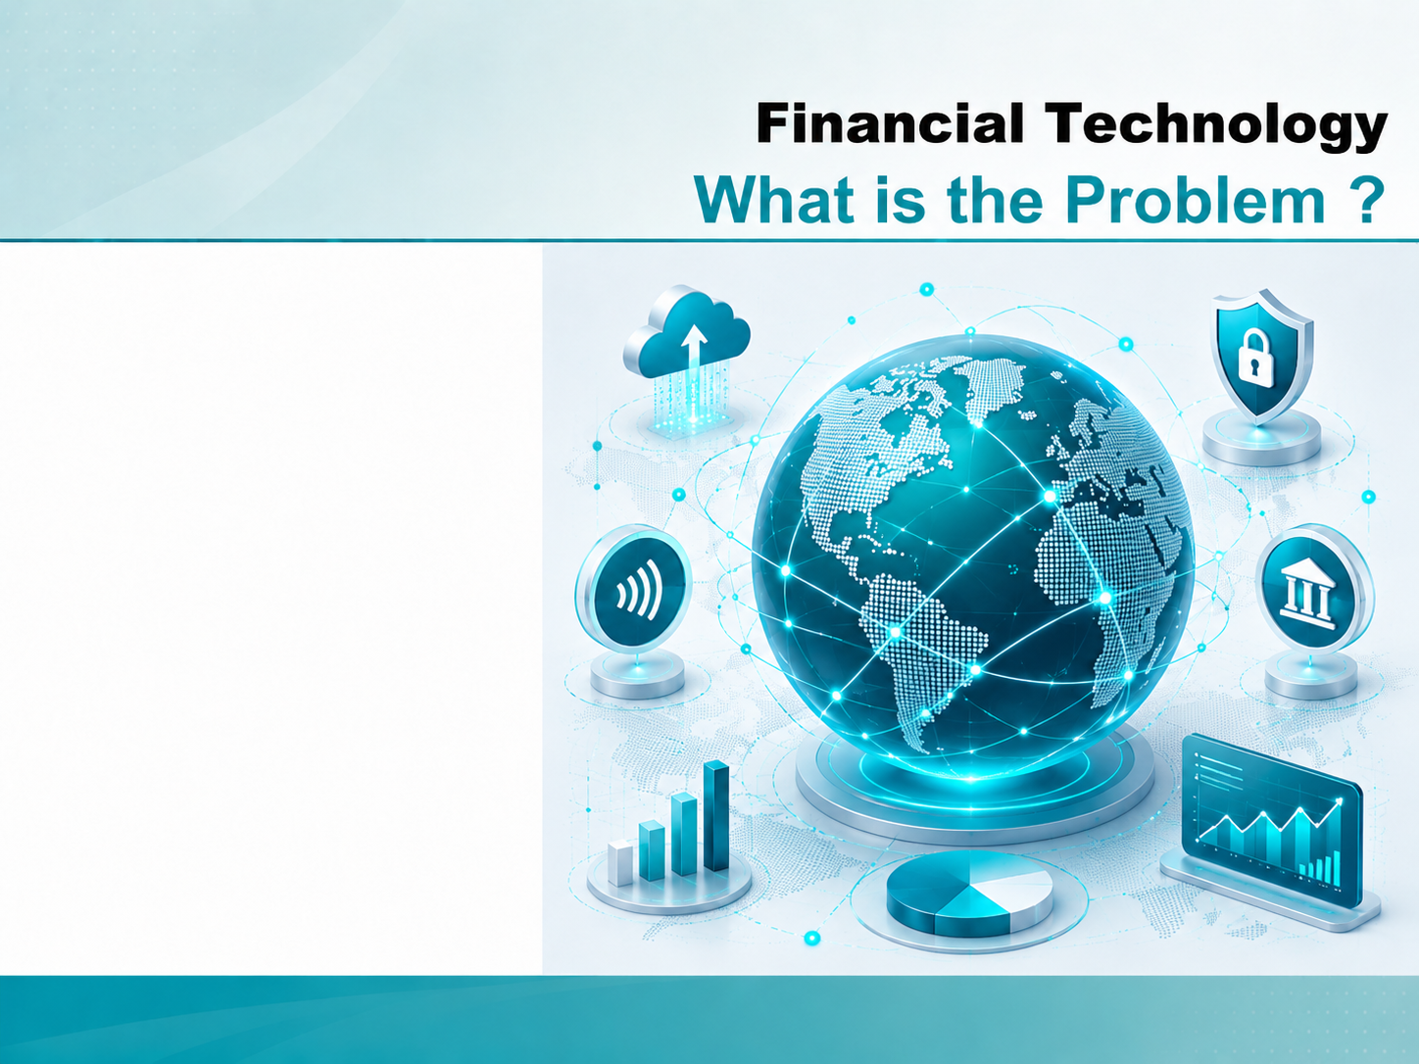
BigTech (TechFin)
BugTechs
(TechFin)

Slide 6
Financial Technology – Big Techs (GAFA Banks) :
1.1. BigTech and TechFin
Large technology companies appear uniquely well-positioned to disrupt the financial sector in ways that few fintech startups or established financial institutions can match.
Unlike new fintech ventures, these tech giants don't need to build a customer base from scratch—they already command a user base that exceeds that of any fintech or traditional bank.
These companies engage with their users frequently, have accumulated years of data to tailor their services effectively, and perhaps most crucially for financial services, they have obtained substantial user trust.
Notes:
Engagement and Activity Slides
Note:
Include at least one engagement element where appropriate:
Think–Pair–Share
Mini task
Poll or reflection question
Suggested duration: 3–5 minutes
Activities shall align with learning outcomes

Slide 7
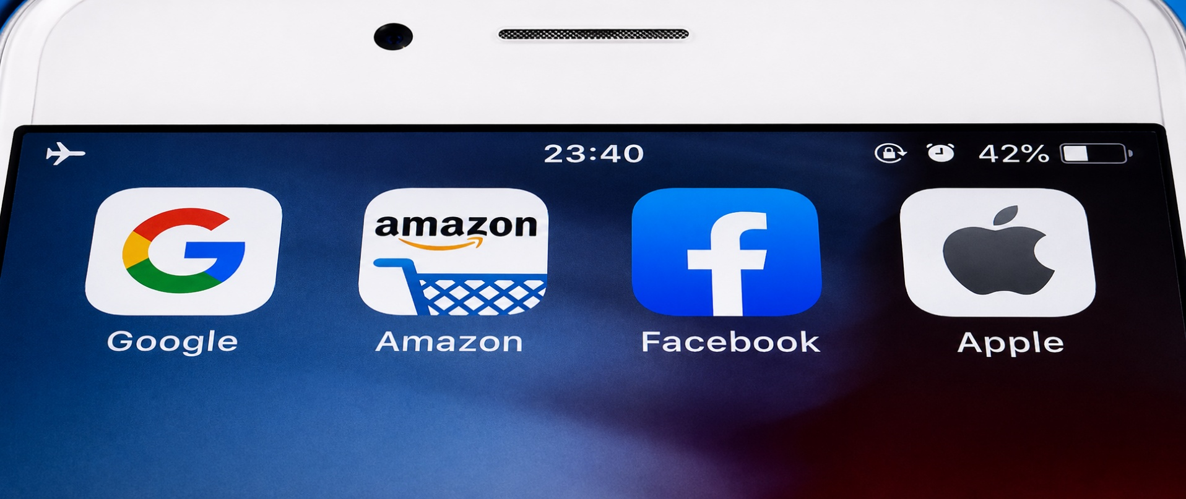
Financial Technology – Big Techs (GAFA Banks) :
1.1. Big Techs in FS
Both traditional lenders and neobanks are facing growing competition from large technology companies. Google, Apple, Facebook and Amazon (aka GAFA), and Asian internet and e-commerce firms like Baidu, Alibaba and Tencent (BAT) have made rapid progress in digital financial services.
Notes:
Engagement and Activity Slides
Note:
Include at least one engagement element where appropriate:
Think–Pair–Share
Mini task
Poll or reflection question
Suggested duration: 3–5 minutes
Activities shall align with learning outcomes

Slide 8
Financial Technology – Big Techs (GAFA Banks) :
1.1. Big Techs in FS - Strengths
Big techs enjoy several advantages over incumbent banks, ranging from a large user base and low online acquisition costs to big data insights supporting pricing and risk management, and internet banking licences. They tend to see expanding into financial services not as the ultimate goal, but a tool to further increase customer loyalty.
When it comes to the quality and speed of service, the biggest strengths of tech companies compared to traditional lenders include providing a first-class customer experience. Many consumers now have a stronger emotional connection with tech brands, like Apple, Google and Amazon, than with their primary banks, data from Deloitte shows.
Notes:
Engagement and Activity Slides
Note:
Include at least one engagement element where appropriate:
Think–Pair–Share
Mini task
Poll or reflection question
Suggested duration: 3–5 minutes
Activities shall align with learning outcomes

Slide 9
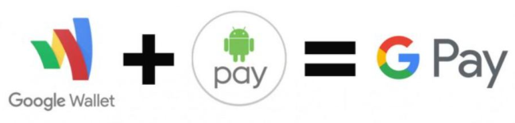
Financial Technology – Big Techs (GAFA Banks) :
1.1. Big Techs in FS - Google
Google’s main incentive in entering financial services is access to data. By entering financial services, they will gain access to a completely new data source that they can use to make their core business even more profitable.
Much of Google’s revenues come from placing ads next to the results of their clients’ queries. Making the responses to these queries more accurate, and the ads placed next to them more relevant, will generate more revenue for Google.
Notes:
Engagement and Activity Slides
Note:
Include at least one engagement element where appropriate:
Think–Pair–Share
Mini task
Poll or reflection question
Suggested duration: 3–5 minutes
Activities shall align with learning outcomes

Slide 10

Financial Technology – Big Techs (GAFA Banks) :
1.1. Big Techs in FS - Amazon
In recognising its information leadership, Amazon opened Amazon Web Services (AWS) to become the largest cloud-computing firm out there. Amazon now adds server systems to AWS every day.
That’s information warfare: leveraging systems expertise to get more share of wallet, expansion of market, growth of proposition and development of the offer into a range of services with no dependency on one particular area.
Notes:
Engagement and Activity Slides
Note:
Include at least one engagement element where appropriate:
Think–Pair–Share
Mini task
Poll or reflection question
Suggested duration: 3–5 minutes
Activities shall align with learning outcomes

Slide 11
Big Techs in FS - Amazon
Amazon already sell some financial products. hey have offered consumer cards for many years and are looking at working capital finance to support their merchants — all through partners. Most recently, they have announced the launch of a current account in partnership with JPMorgan Chase (JPMC). This latest offering could be indication of new things to come.
The real prize is to authenticate and rate their customers so that they can buy relevant financial products (loans, mortgages, savings accounts, pensions etc) at the click of a button — as they would buy any other product on Amazon. Amazon would display only products for which the customer is pre-approved by third party financial services businesses and banks. This would provide customers unprecedented range and ease in buying the financial products they need.
Notes:
Engagement and Activity Slides
Note:
Include at least one engagement element where appropriate:
Think–Pair–Share
Mini task
Poll or reflection question
Suggested duration: 3–5 minutes
Activities shall align with learning outcomes

Slide 12
Big Techs in FS - Amazon
The launch of the current account with JPMC (JP Morgan Chase) could be the first step in creating a platform through which Amazon can sell other financial products. In this scenario Amazon — and not the banks — could become the first port of call when customers look for a new financial product.
As a retailer, Amazon wants to sell more products. By providing a current account, they can get a much better understanding of their customers’ financial characteristics and score them accordingly. The lowest hanging fruit here is to offer point of sale financing, increasing the sales of their core products.
Amazon and Stripe are 'significantly expanding' their partnership, with Stripe becoming a strategic payments partner in Europe, the US and Canada.
Notes:
Engagement and Activity Slides
Note:
Include at least one engagement element where appropriate:
Think–Pair–Share
Mini task
Poll or reflection question
Suggested duration: 3–5 minutes
Activities shall align with learning outcomes

Slide 13
Big Techs in FS - Amazon
Stripe becomes a strategic payments partner for Amazon in the US, Europe and Canada, processing a significant portion of payments volume across businesses like Prime, Audible, Kindle and Amazon Pay.
The reciprocal agreement will also see Stripe make more use of Amazon Web Services (AWS), the ecommerce giant’s cloud infrastructure platform, to run and grow its business. Stripe’s reliance on AWS has already allowed it to scale and support millions of online businesses
Notes:
Engagement and Activity Slides
Note:
Include at least one engagement element where appropriate:
Think–Pair–Share
Mini task
Poll or reflection question
Suggested duration: 3–5 minutes
Activities shall align with learning outcomes

Slide 14

Financial Technology – Big Techs (GAFA Banks) :
1.1. Big Techs in FS – Facebook (Meta)
Facebook/Meta has an advertising driven revenue model. They provide content their users care for — often original content created by their users and their friends — and they show them ads relevant to these posts in the process. The more time users spend on Facebook, the more ads they will see and therefore the more Facebook will earn.
Facebook is interested in providing financial services for two reasons.
access to their users’ financial data, to complement the data they already collect on them, would deeply enhance the accuracy of their targeted ads.
providing a successful payment platform would help create new revenue streams beyond their traditional ad models.
Notes:
Engagement and Activity Slides
Note:
Include at least one engagement element where appropriate:
Think–Pair–Share
Mini task
Poll or reflection question
Suggested duration: 3–5 minutes
Activities shall align with learning outcomes

Slide 15
Financial Technology – Big Techs (GAFA Banks) :
1.1. Big Techs in FS – Facebook (Meta)
The model they probably aspire to is that of WeChat in China, where users can complete many of their daily tasks while on the app — from messaging friends and booking restaurants to paying for taxis and babysitters. The success of Tencent — WeChat’s owner — is enviable.
Notes:
Engagement and Activity Slides
Note:
Include at least one engagement element where appropriate:
Think–Pair–Share
Mini task
Poll or reflection question
Suggested duration: 3–5 minutes
Activities shall align with learning outcomes

Slide 16

Financial Technology – Big Techs (GAFA Banks) :
1.1. Big Techs in FS – Apple
Apple is expanding its consumer financial services offerings as it seeks to broaden the use of iPhones with banking and simple payment and credit features.
The company operates a payments network with Apple Pay and offers a credit card. It has plans to allow people to use iPhones as point-of-sale devices and to offer “buy now, pay later” lending later 2022.
Apple has entered the market with Apple Pay, a mobile payment and digital wallet service
Notes:
Engagement and Activity Slides
Note:
Include at least one engagement element where appropriate:
Think–Pair–Share
Mini task
Poll or reflection question
Suggested duration: 3–5 minutes
Activities shall align with learning outcomes

Slide 17
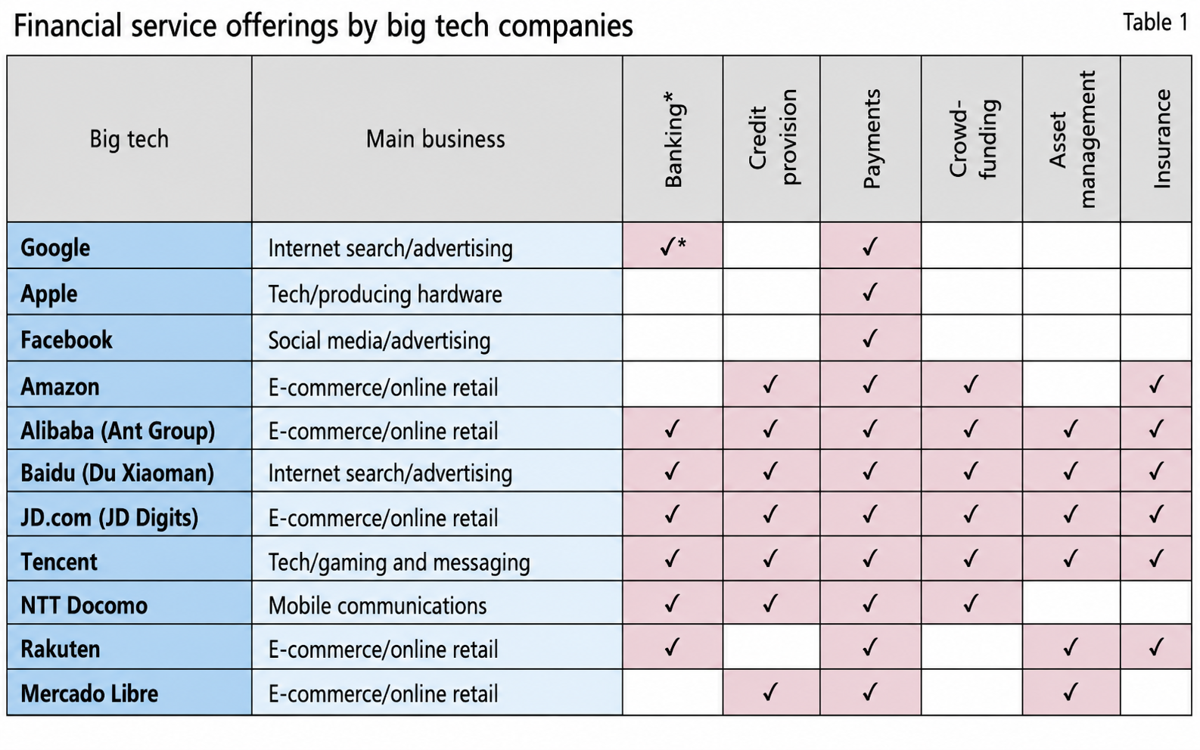
Financial Technology – Big Techs (GAFA Banks) :
1.1. Big Techs in FS
Notes:
Engagement and Activity Slides
Note:
Include at least one engagement element where appropriate:
Think–Pair–Share
Mini task
Poll or reflection question
Suggested duration: 3–5 minutes
Activities shall align with learning outcomes

Slide 18
Financial Technology – Big Techs (GAFA Banks) :
1.1. Big Techs in FS
What is most striking about the GAFA interest in banking is that they do not seem to care too much about the actual financial services revenue. In entering the financial services industry, GAFA and other Big Tech have access to four assets and one liability:
they have many millions of customers they can engage with
they understand what motivates their customers,
they have access to a broad talent pool,
they have huge capital reserves to invest.
Their one liability: their brand.
Notes:
Engagement and Activity Slides
Note:
Include at least one engagement element where appropriate:
Think–Pair–Share
Mini task
Poll or reflection question
Suggested duration: 3–5 minutes
Activities shall align with learning outcomes

Slide 19
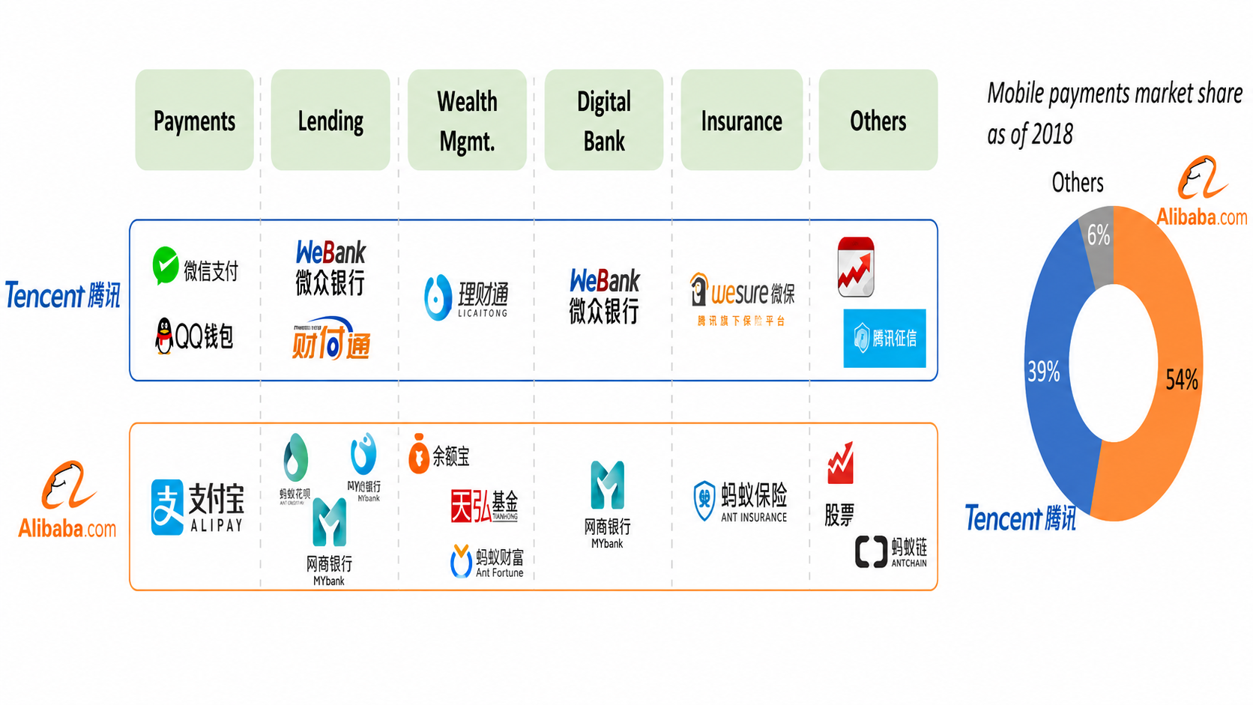
Financial Technology – Big Techs (GAFA Banks) :
1.1. Big Techs – Platform ecosystems – Super Apps
Notes:
Engagement and Activity Slides
Note:
Include at least one engagement element where appropriate:
Think–Pair–Share
Mini task
Poll or reflection question
Suggested duration: 3–5 minutes
Activities shall align with learning outcomes

Slide 20
BigTech (TechFin)
China as a Template for Growth of TechFin

Slide 21
Financial Technology – Big Techs (TechFin) :
1.1. China as a Template for the Growth of Techfin
Indeed, the potential for large technology companies to dominate the delivery of financial services to retail customers is not just an idea: it’s a reality in a number of Asian markets. Most notable among them is China, where technology firms Tencent and Alibaba have successfully integrated extensive consumer payment, lending, and investment services into their digital offerings.
Similarly, Alibaba issued small business loans of about $63.4 billion in 2017, equalling 30% of the loans extended by the Industrial and Commercial Bank of China, the top small business lender in China.
Alibaba has 400 million active monthly users for its AliPay Wallet.
Notes:
Engagement and Activity Slides
Note:
Include at least one engagement element where appropriate:
Think–Pair–Share
Mini task
Poll or reflection question
Suggested duration: 3–5 minutes
Activities shall align with learning outcomes

Slide 22
China as a Template for the Growth of Techfin
In China, WeChat’s vast user base provides a ready-made market for Tencent Holdings’ new bank joint venture, the purely online WeBank.
If WeChat users can be converted into banking customers, mobile transactions and payments solutions are clear areas of opportunity. WeBank will also be able to take advantage of Tencent’s extensive online experience and access to large amounts of customer behavior information to offer differentiated financial products.
Notes:
Engagement and Activity Slides
Note:
Include at least one engagement element where appropriate:
Think–Pair–Share
Mini task
Poll or reflection question
Suggested duration: 3–5 minutes
Activities shall align with learning outcomes

Slide 23
Financial Technology – Big Techs (TechFin) :
1.1. Alibaba’s and Tencent’s Transformation of Payments in China
In 2004, e-commerce giant Alibaba launched Alipay to facilitate online payments. Tencent entered the space later with the launch of their mobile-only messaging app called WeChat in 2011. Over the ensuing years, both apps, and the services they provide, have continually evolved and their user bases have grown rapidly, transforming the landscape of payments in China.
WeChat now has over 1 billion users globally (approximately 70 million of whom are outside of China), with 800 million using WeChat Pay, while Alipay has over 620 million users.
Notes:
Engagement and Activity Slides
Note:
Include at least one engagement element where appropriate:
Think–Pair–Share
Mini task
Poll or reflection question
Suggested duration: 3–5 minutes
Activities shall align with learning outcomes

Slide 24
Alibaba’s and Tencent’s Transformation of Payments in China
An astounding 600 million payments are made each day using WeChat, and as of 2016, the two technology giants controlled 90% of the 58.8 trillion yuan (approximately, US$8.8 trillion in 2016) Chinese consumers spent via their phones that year.
These numbers dwarf those found in the West. Consider how the user numbers of WeChat and Alipay compare to the 25 million active users of the Bank of America mobile app or the miniscule US$112 billion in mobile payment transactions that Forrester Research estimates are made by US consumers.
Notes:
Engagement and Activity Slides
Note:
Include at least one engagement element where appropriate:
Think–Pair–Share
Mini task
Poll or reflection question
Suggested duration: 3–5 minutes
Activities shall align with learning outcomes

Slide 25
Financial Technology – Big Techs (TechFin) :
1.1. Alibaba’s and Tencent’s Transformation of Payments
Having dominated the payments space, Alibaba and Tencent have sought to expand their suite of financial offerings to include an array of services such as loans, credit scoring, and wealth management
Ant Financial, Alibaba’s financial arm which includes Alipay, runs the world’s biggest money market fund, called Yu’e Bao that had US$266 billion worth of assets under management as of March 2018.10 This is about six times the size of JPMorgan’s Prime Money Market Fund. Tencent also offers extensive wealth management products by providing direct access through apps to products from one of the country’s largest mutual fund managers.
Notes:
Engagement and Activity Slides
Note:
Include at least one engagement element where appropriate:
Think–Pair–Share
Mini task
Poll or reflection question
Suggested duration: 3–5 minutes
Activities shall align with learning outcomes

Slide 26
Alibaba’s and Tencent’s Transformation of Payments
Alibaba’s and Tencent’s agile technology capabilities and their ability to leverage their customers’ payment data has allowed them to deploy and rapidly scale targeted offerings designed to both serve highly specific markets and create opportunities for later expansion.
For example, MyBank, launched by Alibaba in 2015, is designed to provide inclusive and innovative financial solutions for individuals and small enterprises that were previously unbanked or underbanked.
One interesting consumer implication of the adoption of techfin in China is that Chinese consumers’ financial lives are much more tightly intertwined with other aspects of their digital lives than even the most tech-savvy North American or European consumer.
Notes:
Engagement and Activity Slides
Note:
Include at least one engagement element where appropriate:
Think–Pair–Share
Mini task
Poll or reflection question
Suggested duration: 3–5 minutes
Activities shall align with learning outcomes

Slide 27
Alibaba’s and Tencent’s Transformation of Payments
WeChat in particular has truly evolved from a messaging app or a mobile payment solution to a lifestyle platform for its users. WeChat users can transfer money to their contacts, pay bills, buy financial products, book hotels and taxis, and access many other services all on the same platform.
The app even plays an important role in connecting individuals during important holidays. During the 2018 Chinese New Year, 688 million WeChat users either sent or received digital red envelopes (a Chinese tradition where friends, family, and colleagues gift each other red envelopes with money).
The broad range of services WeChat provides enables users to spend more time on the app than they would on any other platform. More than one-third of its users spend over four hours a day on the service—a massive amount, even when compared to other highly successful digital services such as Facebook, whose average user spends just 22 minutes a day on the platform.
Notes:
Engagement and Activity Slides
Note:
Include at least one engagement element where appropriate:
Think–Pair–Share
Mini task
Poll or reflection question
Suggested duration: 3–5 minutes
Activities shall align with learning outcomes

Slide 28
Financial Technology – Big Techs (TechFin) :
1.1. Alibaba’s and Tencent’s International Expansion
Having conquered their home market, these Chinese techfins have begun to explore international expansion. WeChat now has over 70 million users outside of China (though many of these do not have access to the full suite of services available to users in China), and WeChat Pay is available today in 25 countries and 13 currencies with a primary focus on other ASEAN countries.
For its part, Alibaba and its financial services–focused subsidiary Ant Financial have a combined shareholding of 62% of Indian e-commerce and payment giant Paytm, which reportedly has over 100 million users and processes over one billion transactions per quarter.
Notes:
Engagement and Activity Slides
Note:
Include at least one engagement element where appropriate:
Think–Pair–Share
Mini task
Poll or reflection question
Suggested duration: 3–5 minutes
Activities shall align with learning outcomes

Slide 29
Alibaba’s and Tencent’s International Expansion
For now, efforts of Alibaba and Tencent seem focused on Asia, but with Alipay terminals popping up in Honolulu to serve Chinese tourists and WeChat advertisements now visible in the London Underground, it seems plausible that the ambitions of these firms are global
Notes:
Engagement and Activity Slides
Note:
Include at least one engagement element where appropriate:
Think–Pair–Share
Mini task
Poll or reflection question
Suggested duration: 3–5 minutes
Activities shall align with learning outcomes

Slide 30
BigTech (TechFin)
Incumbents
Banks vs
BigTechs

Slide 31
Financial Technology – Big Techs (TechFin) :
1.1. Incumbent Banks - Advantages
Specifically, traditional banks and insurers can leverage existing assets that give unique advantages over non- traditional challengers in their industries, namely:
Untapped Reservoirs of Customer Data – With data mining and predictive analytics, the hidden value in the first of these assets – massive stores of day-to-day transactional customer data – can provide a unique advantage in better understanding, predicting and delivering what customers want, while helping to better address risk, fraud and market uncertainties.
Notes:
Engagement and Activity Slides
Note:
Include at least one engagement element where appropriate:
Think–Pair–Share
Mini task
Poll or reflection question
Suggested duration: 3–5 minutes
Activities shall align with learning outcomes

Slide 32
Incumbent Banks - Advantages
An Extensive Branch / Office Network – The second asset, physical branch or office networks, can seem like merely a cost overhead, but it can play a vital role in developing meaningful customer relationships as financial services become increasingly digitized. As the online giants are learning, digital-only relationships have their limits: a binding customer experience is built on both physical and digital touchpoints.
Stronger Customer Trust – The existing physical touchpoints for traditional financial services companies can also serve to reinforce an important third asset: trust. While the financial crisis did shake consumer confidence, individuals’ trust in traditional financial institutions remains strong.
Notes:
Engagement and Activity Slides
Note:
Include at least one engagement element where appropriate:
Think–Pair–Share
Mini task
Poll or reflection question
Suggested duration: 3–5 minutes
Activities shall align with learning outcomes

Slide 33
Incumbent Banks - Advantages
According to an IBM survey, 70 percent of respondents indicate that they trust traditional banks more than non-bank competitors, and when asked in another survey which institution they trust more to safeguard their personal information and privacy, consumers ranked traditional financial institutions higher by a wide margin over new online providers.
People with Quantitative Skills and Industry Expertise, Traditional financial service companies have a further advantage in having long employed professionals with advanced mathematical and statistical skills, providing them with a ready workforce of industry-savvy quantitative experts who can be trained to compete with GAFA and fintech on what has to date been their primary home field advantage: an adroit use of big data and algorithms to create great customer experiences in the digital, and increasingly the physical, spheres. In other words, banks and insurance companies are well-positioned to master data science.
Notes:
Engagement and Activity Slides
Note:
Include at least one engagement element where appropriate:
Think–Pair–Share
Mini task
Poll or reflection question
Suggested duration: 3–5 minutes
Activities shall align with learning outcomes

Slide 34
BigTech (TechFin)
Conclusion

Slide 35
Financial Technology – Big Techs (TechFin) :
1.1. Conclusion
The threat from Big Tech firms may encourage banks and FinTechs to strengthen their relationships, given that they have more to lose to Google and Amazon than to the new competitors in their usual turf.
Notes:
Engagement and Activity Slides
Note:
Include at least one engagement element where appropriate:
Think–Pair–Share
Mini task
Poll or reflection question
Suggested duration: 3–5 minutes
Activities shall align with learning outcomes

Slide 36
SUMMARY
By the end of this session:
Defining Digital Banking: Introduces the core concept of digital-only banks, specifically distinguishing between "Neobanks" and "Challenger Banks," while detailing the prerequisites needed to operate them.
Market Examples & Strengths: Reviews real-world examples of these digital banks to highlight their general competitive strengths in the financial sector.
Cost Efficiency: Explores the financial value proposition of neobanks, focusing on how their tech-driven structure allows for significantly lower operational costs and reduced consumer fees.
Agility & Innovation: Highlights how digital banks leverage modern technological infrastructure to build open ecosystems and launch new products much faster than traditional counterparts.
Enhanced Customer Experience: Emphasizes their competitive edge in delivering a superior, highly personalized customer journey built on transparency and security.
Notes:
Summary and Closure Slides
Note:
Summarise 3–5 key takeaways
Reinforce main ideas
Indicate CLO coverage where appropriate
Include:
Upcoming topics
Required reading
Tutorial / lab / assessment linkage

Slide 37

THANK YOU
Shuhaida Bt M Shuhidan
DEPARTMENT OF COMPUTING
shuhaida.shuhidan@utp.edu.my
01-03-31

